Slide 1
Bayesian vs. Frequentism
for experimentalists

Slide 2


Overview:
Objective of talk: Compare Bayesian vs Frequentism for some simple examples.
Part 1: What question is Bayesian and Frequentist analysis answering?
Part 2: How to deal with nuisance parameters?

Slide 3
Background

Slide 4
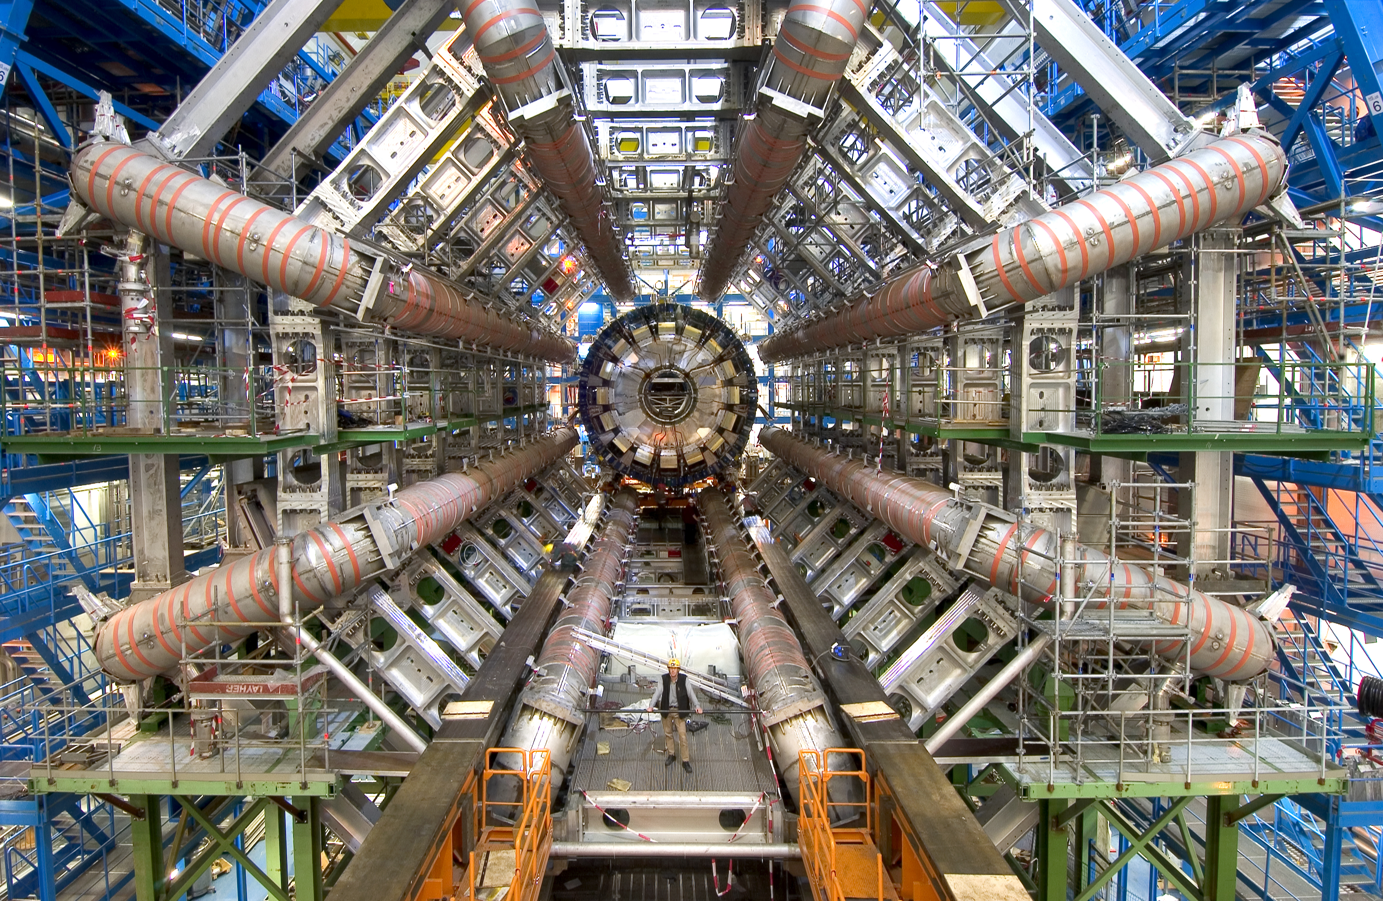
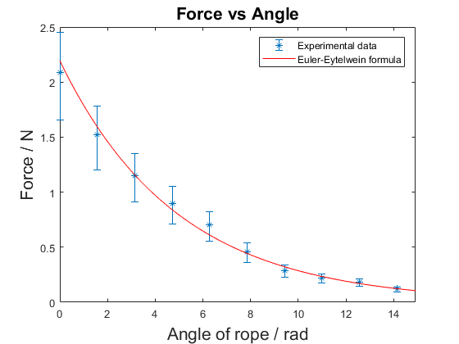
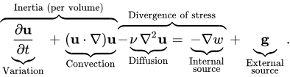
Background: Mathematical Physicist
Physics in the context of statistics:
Most investigations are experimental (rather then observational)
Focus on effect estimation (rather then effect existence)
Advanced models & simple analysis
Statistics has relatively weak standing
No formal statistical training

Slide 5
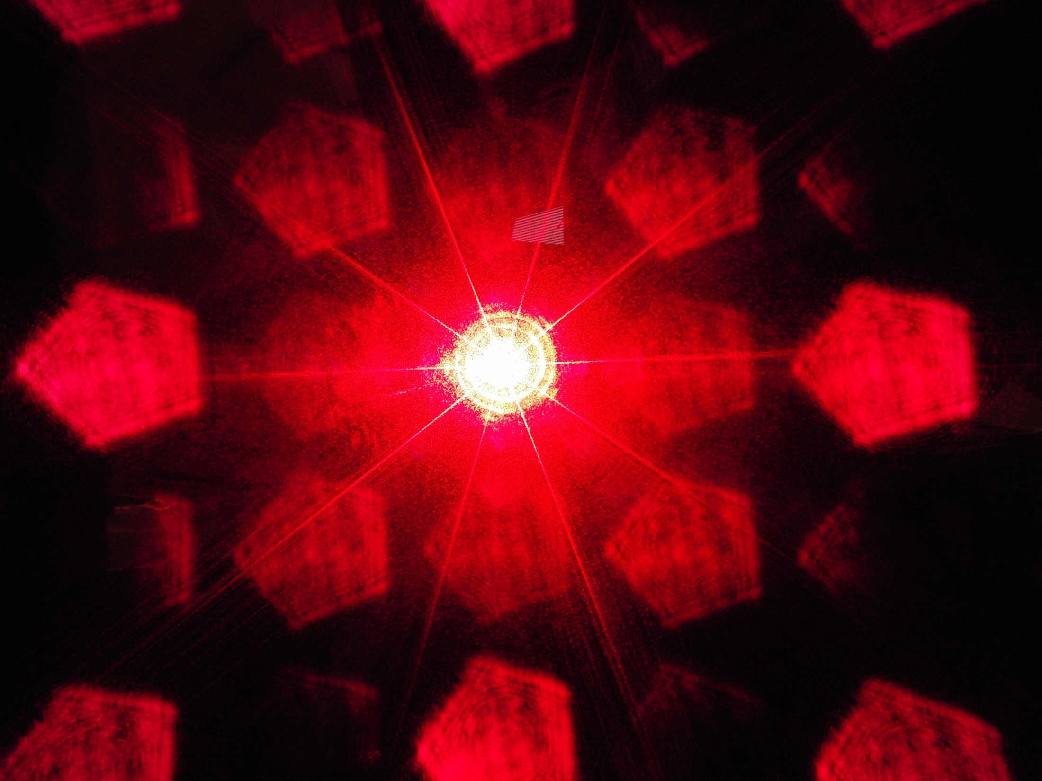

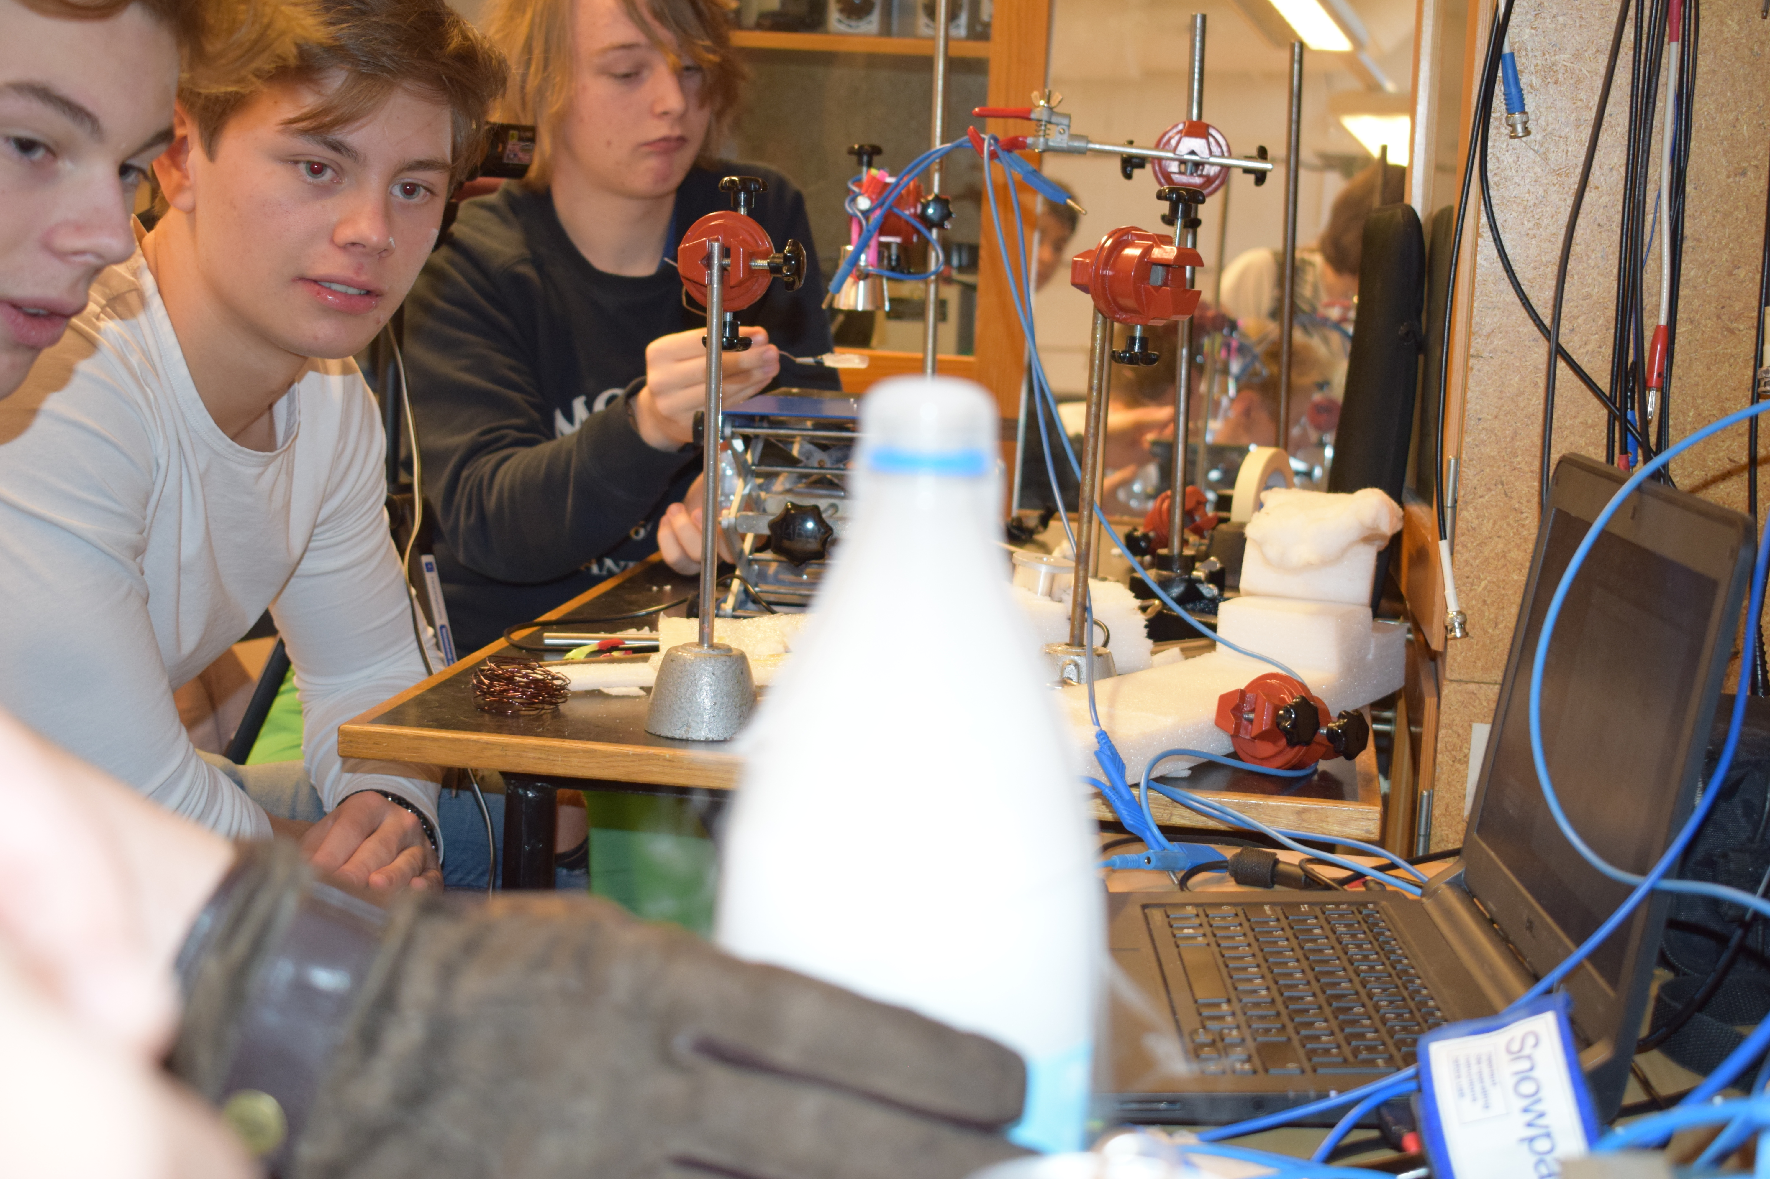
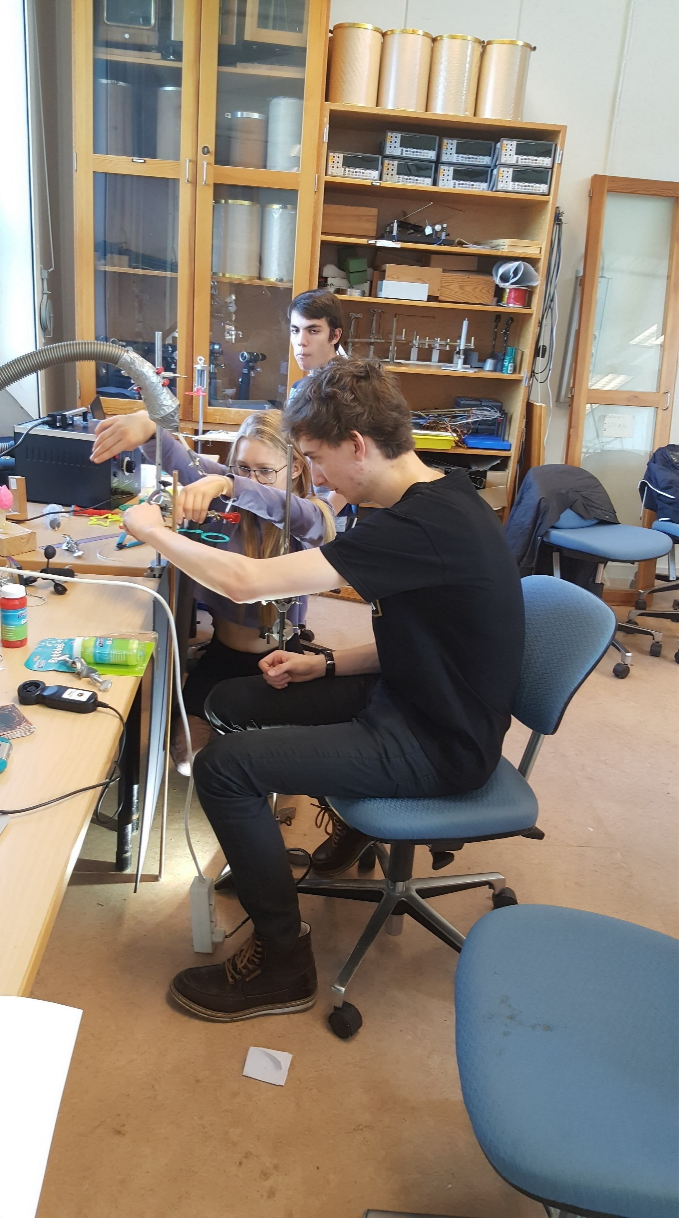
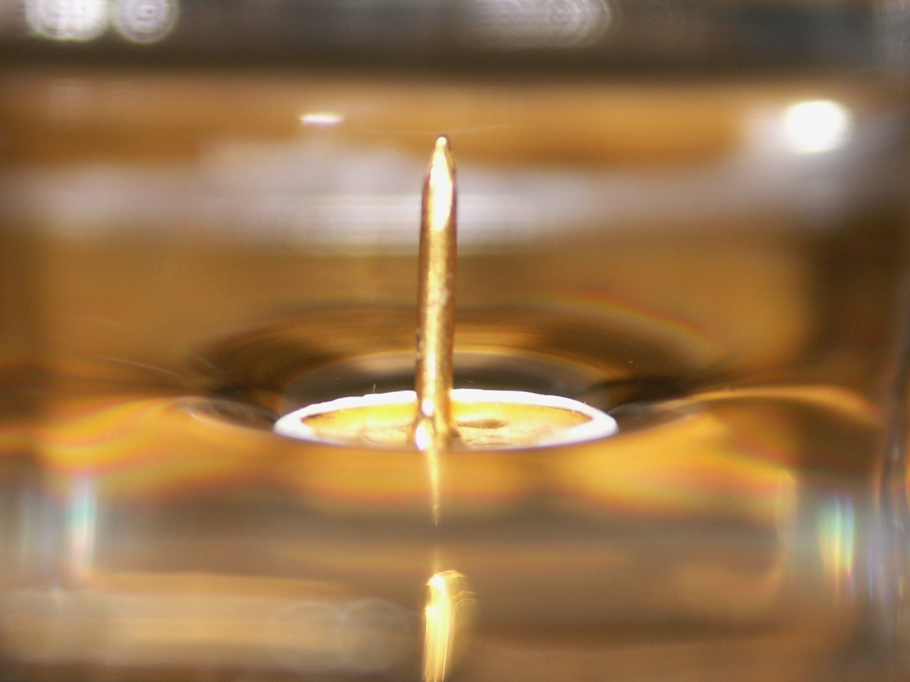
Background: IYPT
IYPT: International Young Physicists’ Tournament
A high school competition aimed at doing real physics research
Investigation of practical everyday phenomena.
Experimental and theoretical analysis required
How to compare? Statistics!

Slide 6
Part 1: What question is Bayesian and Frequentist analysis answering?

Slide 7

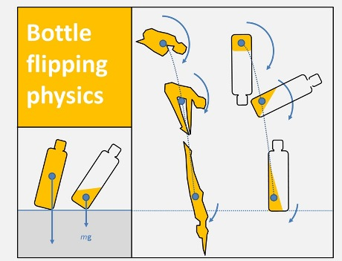
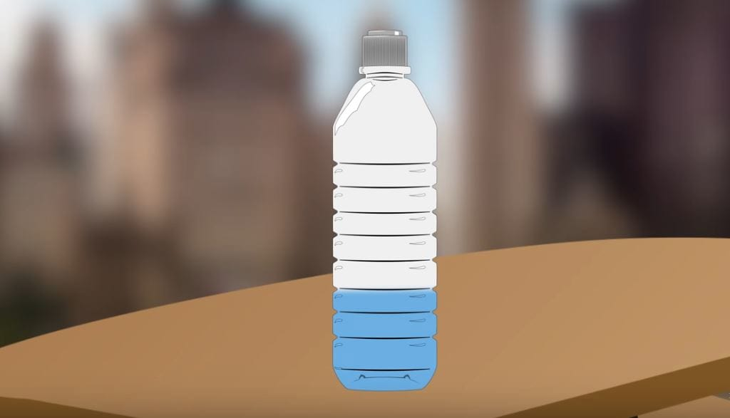
A first example
Bottle flipping: How to optimize?
Water level crucial: Lowers center of gravity
How to demonstrate the effect?
Dropping the bottle straight
Number of times standing up recorded

Slide 8
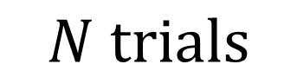
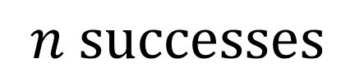
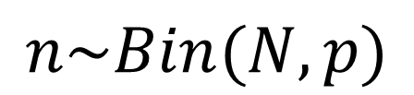
Statistical analysis
$$n successes$$
$$N trials$$
$$n\sim Bin(N,p)$$
Unknown parameter

Slide 9
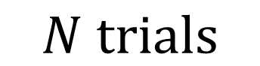
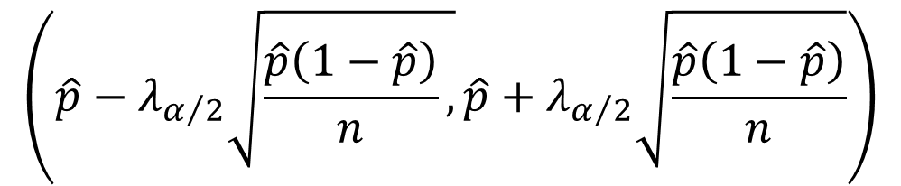
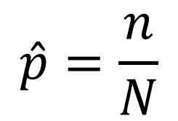
Statistical analysis: Frequentism
$$n successes$$
$$N trials$$
$$n\sim Bin(N,p)$$
Unknown parameter
$$\hat{p}=\frac{n}{N}$$
ML Estimator
$$\left(\hat{p}−λ_{α/2}\sqrt{\frac{\hat{p}\left(1−\hat{p}\right)}{n},}\hat{p}+λ_{α/2}\sqrt{\frac{\hat{p}\left(1−\hat{p}\right)}{n}}\right)$$
95 % confidence interval

Slide 10
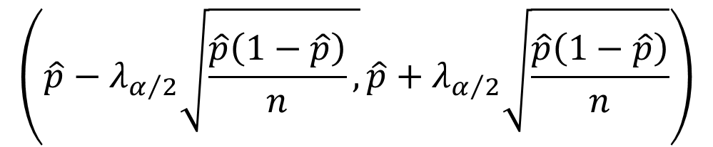
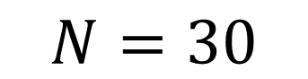
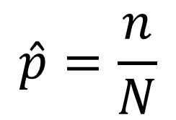

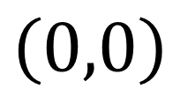
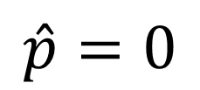
Statistical analysis: Frequentism
$$n=0$$
$$n successes$$
$$N=30$$
$$N trials$$
$$n\sim Bin(N,p)$$
Unknown parameter
$$\hat{p}=\frac{n}{N}$$
$$\hat{p}=0$$
Estimator
$$\left(\hat{p}−λ_{α/2}\sqrt{\frac{\hat{p}\left(1−\hat{p}\right)}{n},}\hat{p}+λ_{α/2}\sqrt{\frac{\hat{p}\left(1−\hat{p}\right)}{n}}\right)$$
$$\left(0,0\right)$$
100 % confidence interval
95 % confidence interval
Are we certain the bottle will never stand up?

Slide 11
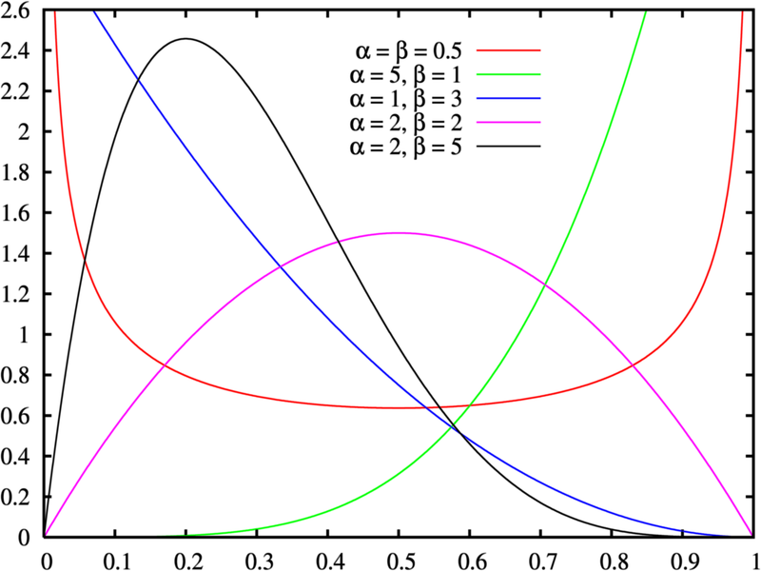
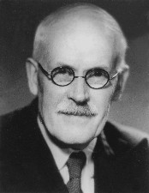
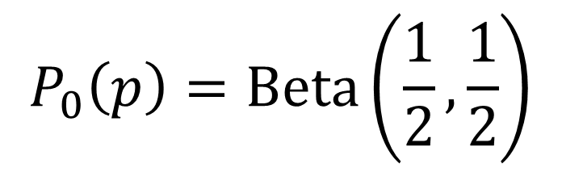
Statistical analysis: Bayesian
$$n successes$$
$$N trials$$
$$n\sim Bin(N,p)$$
Unknown parameter
What prior?
Uninformative:
Jeffery prior
$$P_{0}\left(p\right)=Beta\left(\frac{1}{2},\frac{1}{2}\right)$$

Slide 12
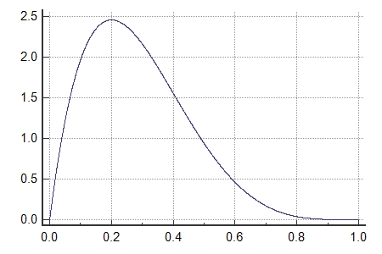
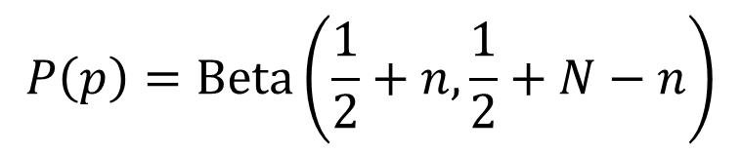
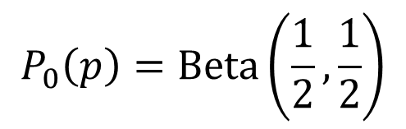
Statistical analysis: Bayesian
$$n successes$$
$$N trials$$
$$n\sim Bin(N,p)$$
Unknown parameter
$$P_{0}\left(p\right)=Beta\left(\frac{1}{2},\frac{1}{2}\right)$$
$$P\left(p\right)=Beta\left(\frac{1}{2}+n,\frac{1}{2}+N−n\right)$$
Prior:
Posterior:
95 % credibility interval

Slide 13
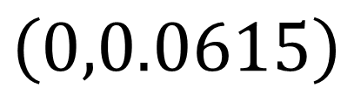
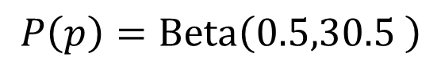
Statistical analysis: Bayesian
$$n=0$$
$$n successes$$
$$N=30$$
$$N trials$$
$$n\sim Bin(N,p)$$
Unknown parameter
$$P_{0}\left(p\right)=Beta\left(\frac{1}{2},\frac{1}{2}\right)$$
$$P\left(p\right)=Beta\left(\frac{1}{2}+n,\frac{1}{2}+N−n\right)$$
Prior:
Posterior:
$$P\left(p\right)=Beta\left(0.5,30.5 \right)$$
$$\left(0,0.0615\right)$$
95 % credibility interval
Existence of uncertainty!

Slide 14
What's going on?
Why are we getting different answers?
Answer 1: Since a prior distribution was used we get different answers.
Answer 2: Different questions were answered:
Frequentist question:
Assume the parameter is equal to the estimated value. What is the spread of the estimator if repeated experiments are carried out?
Bayesian question: Given prior + data what is the probability for the parameter to be a certain value?

Slide 15
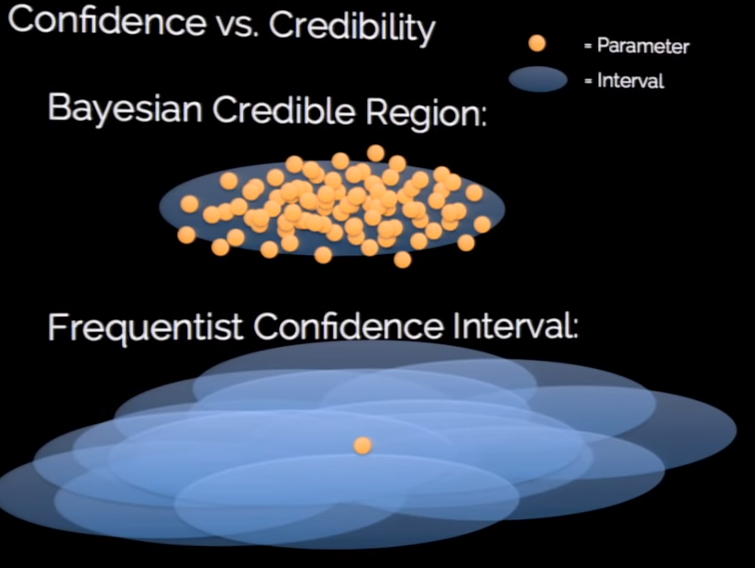
Visualization of the difference
Jake VanderPlas, SciPy 2014

Slide 16
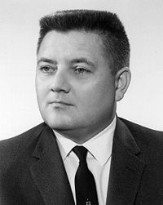
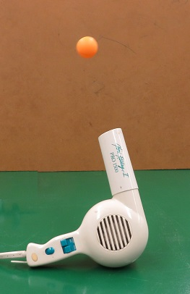
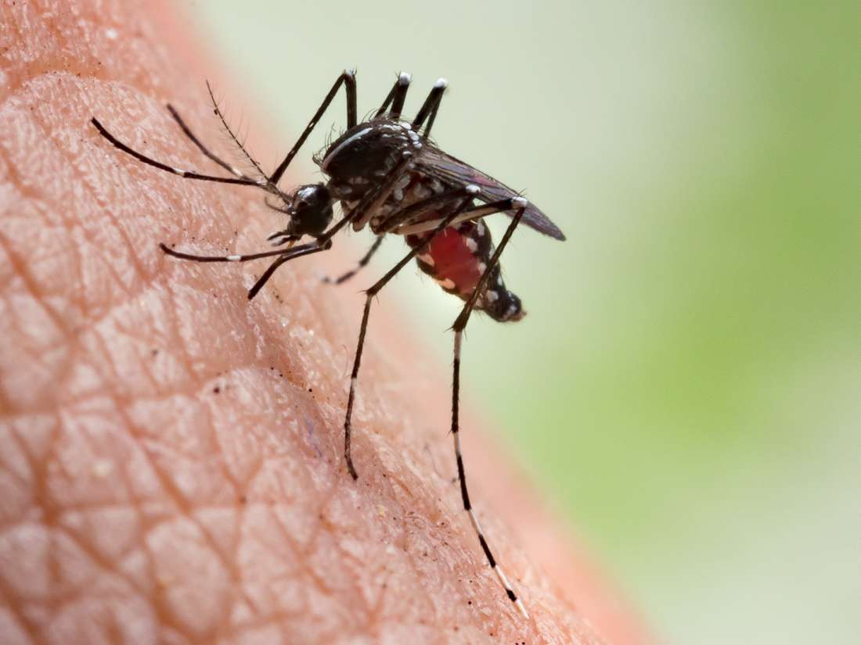
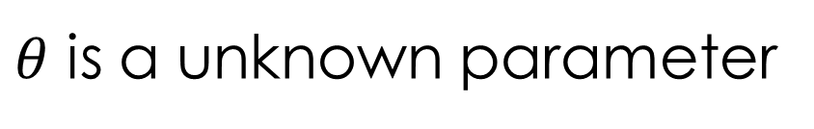
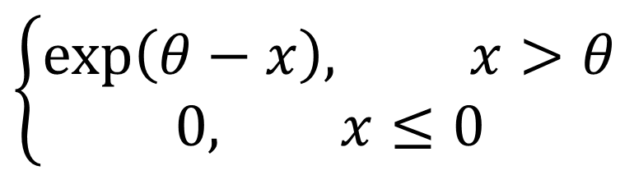
A slightly more non-trivial example
$$\left\{\begin{aligned}\exp\left(θ−x\right), x>θ \\ 0, x≤0\end{aligned}\right.$$
Jaynes Truncated Exponential:
$θ$ is a unknown parameter

Slide 17

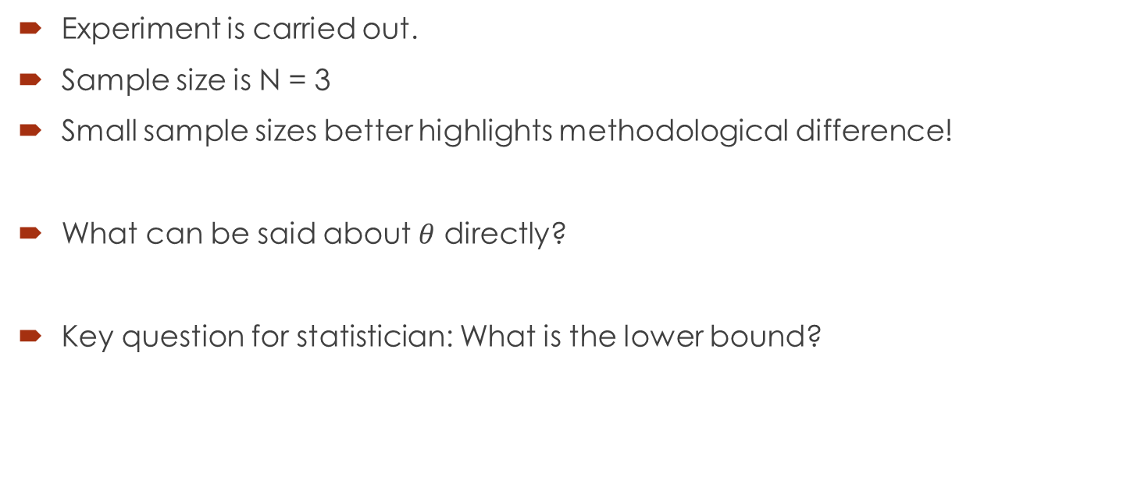
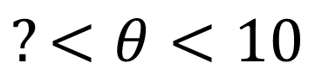
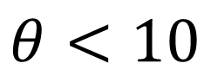
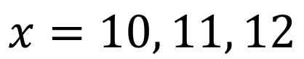
Result of experiments
Experiment is carried out.
Sample size is N = 3
Small sample sizes better highlights methodological difference!
What can be said about $θ$ directly?
Key question for statistician: What is the lower bound?
$$x=10, 11, 12$$
$$θ<10$$
$$?<θ<10$$

Slide 18
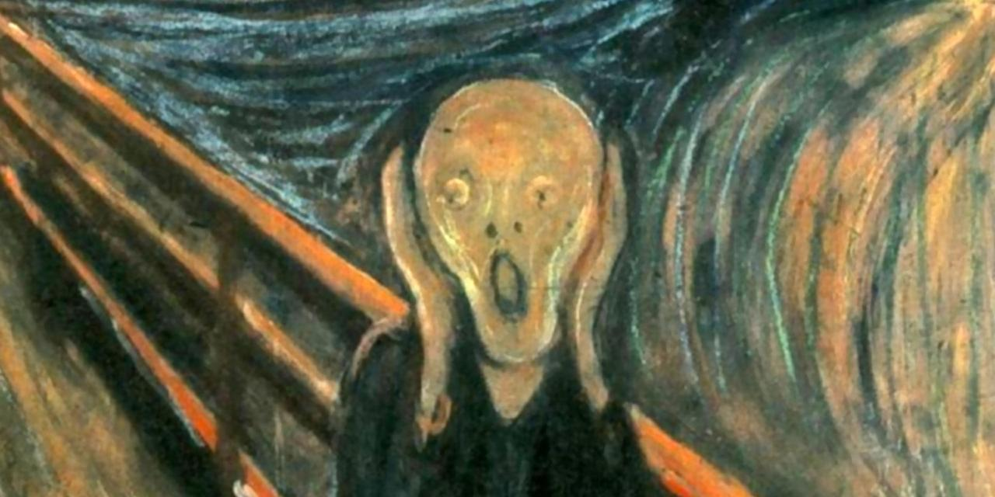
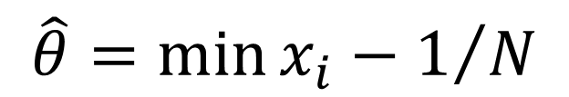
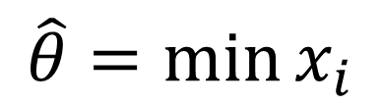
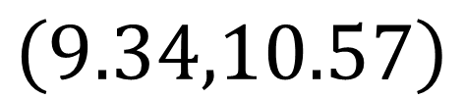
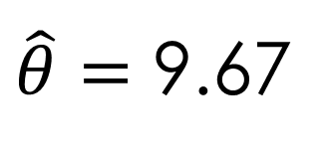
Statistical analysis: Frequentism
$$\hat{θ}=\min{x_{i}}$$
ML Estimator
$$\hat{θ}=\min{x_{i}}−1/N$$
$\hat{θ}=$ 9.67
Unbiased ML Estimator
95 % confidence interval
$$\left(9.34,10.57\right)$$

Slide 19
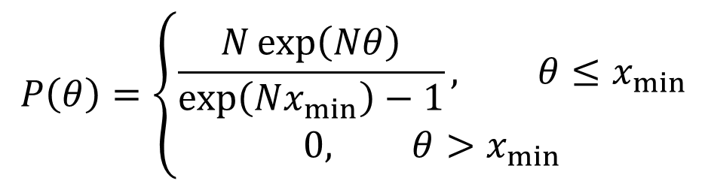
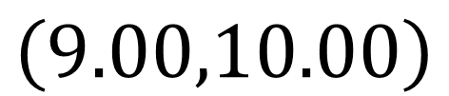
Statistical analysis: Bayesian
What prior?
Translation symmetry in problem: Flat prior
Is that ok?
Posterior will always be proper!
Using Bayes rule:
$$P\left(θ\right)=\left\{\begin{aligned}\frac{N\exp\left(Nθ\right)}{\exp\left(Nx_{min}\right)−1}, θ≤x_{min} \\ 0, θ>x_{min}\end{aligned}\right.$$
95 % credibility interval
$$\left(9.00,10.00\right)$$

Slide 20
Is frequentism wrong?
No! It merely answers a question nobody at the lab asked.
What is then the use of the frequentist idea here?
If future studies were to be conducted, a frequentist analysis of the Bayesian procedure would be called for.

Slide 21
Conclusion of part 1:
Bayesian analysis answers the question an experimentalist typically askes!

Slide 22
Part 2: How to deal with nuisance parameters?

Slide 23
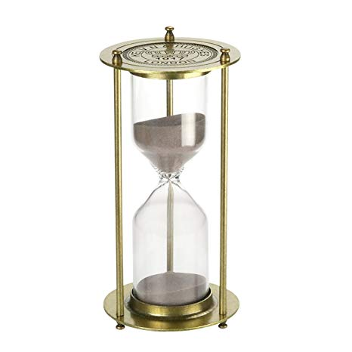
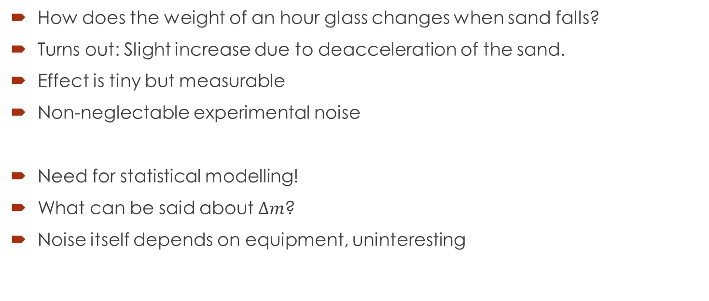
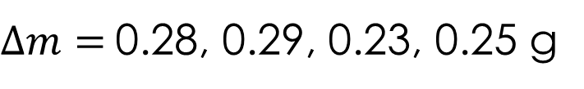
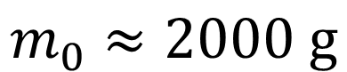
A first example:
How does the weight of an hour glass changes when sand falls?
Turns out: Slight increase due to deacceleration of the sand.
Effect is tiny but measurable
Non-neglectable experimental noise
Need for statistical modelling!
What can be said about $∆m$?
Noise itself depends on equipment, uninteresting
$$m_{0}≈2000 g$$
$∆m=$0.28, 0.29, 0.23, 0.25 g

Slide 24
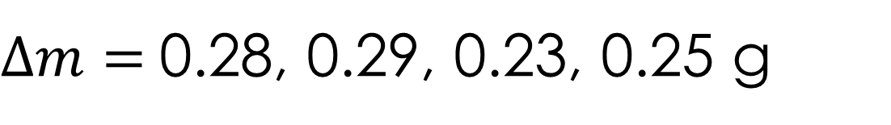

Statistical analysis
$∆m=$0.28, 0.29, 0.23, 0.25 g
Complicated origin of the fluctuation, hard to do first principle model
Small data set, limited options.
Simple choice is to assumed normal distribution
$$∆m\sim N(μ,σ)$$
Unknown parameter
Unknown nuisance parameter

Slide 25




Statistical analysis: Bayesian
What prior?
Flat in $μ$ due to translation symmetry
$$1/σ$$
Flat in $\ln{σ}$ due to scale symmetry
$$∝σ^{−\left(N+1\right)}\exp\left[−\frac{\left(N−1\right){\hat{σ}}^{2}+N{\left(μ−\hat{μ}\right)}^{2}}{2σ^{2}}\right]$$
Joint Posterior:
Posterior for $μ$:
$$\int_{0}^{∞}{dσ}∙σ^{−\left(N+1\right)}\exp\left[−\frac{\left(N−1\right){\hat{σ}}^{2}+N{\left(μ−\hat{μ}\right)}^{2}}{2σ^{2}}\right]∝{\left[\left(N−1\right){\hat{σ}}^{2}+N{\left(μ−\hat{μ}\right)}^{2}\right]}^{N/2}∝t_{N−1}\left(\frac{μ−\hat{μ}}{{\hat{σ}}/{\sqrt{N}}}\right)$$
Posterior for $μ$ is a t-distribution!

Slide 26
Comment on the “surprising” agreement
In many cases with normal models, Bayesian and Frequentist methods will yield same result if a reasonable uninformative prior is used.
Important examples include linear regression models.
However, the new results can be interpreted in in the Bayesian framework: Answering the questions we want!
Makes for smooth interaction with the frequentist majority.
Simple recipe to remove nuisance parameters: Integrate them out. No need for special sampling “tricks”.

Slide 27



A slightly more non-trivial example
Video analysis of pendulum motion
What is the accuracy of the tracking?
Hard to reproduce time series experiments!
Track multiple points on the object.
Angle of both points must be equal.
$$\left\{\begin{aligned}θ_{1,t}\sim N\left(θ_{t},σ\right) \\ θ_{2,t}\sim N\left(θ_{t},σ\right) \end{aligned}\right.$$

Slide 28


Statistical analysis
Unknown nuisance parameters
$$\left\{\begin{aligned}θ_{1,t}\sim N\left(θ_{t},σ\right) \\ θ_{2,t}\sim N\left(θ_{t},σ\right) \end{aligned}\right.$$
Unknown parameter
Goal is to determine $σ$, $θ_{t}$ is nuisance parameters
Data set is often vey large, $N≈1000$
Should be more then sufficient information to pin down $σ$ to correct answer $σ_{0}$if $N→∞$

Slide 29







Statistical analysis: Frequentism
Standard recipe: Write down likelihood for ML estimate
Minimize all parameters simultaneously.
Nuisance parameters solution: ${\hat{θ}}_{i}=\frac{θ_{1,i}+θ_{2,i}}{2}$
Insert into likelihood
Estimator for $σ$
Not consistent!
Known as the Neyman-Scott paradox
$$L\left(θ_{t},σ\right)∝σ^{−2N}\exp\left(\frac{1}{2σ^{2}}\sum_{i=1}^{N}{\left[{\left(θ_{1,i}−θ_{i}\right)}^{2}+{\left(θ_{2,i}−θ_{i}\right)}^{2}\right]}\right)$$
$$L\left(σ\right)∝σ^{−2N}\exp\left(\frac{1}{4σ^{2}}\sum_{i=1}^{N}{{\left(θ_{2,i}−θ_{1,i}\right)}^{2}}\right)$$
${\hat{σ}}^{2}=$ $\frac{1}{4N}\sum_{i=1}^{N}{{\left(θ_{2,i}−θ_{1,i}\right)}^{2}}$
$$\lim_{N→∞}{\hat{σ}}={σ_{0}}/{\sqrt{2}}$$

Slide 30


Statistical analysis: Bayesian
$$P\left(θ_{t},σ\right)∝σ^{−\left(2N+1\right)}\exp\left(\frac{1}{2σ^{2}}\sum_{i=1}^{N}{\left[{\left(θ_{1,i}−θ_{i}\right)}^{2}+{\left(θ_{2,i}−θ_{i}\right)}^{2}\right]}\right)$$
Joint Posterior:
Integrating away the nuisance parameters:
Resulting posterior has correct limiting behaviour
No sign of paradox!
$$P\left(σ\right)∝\int_{−∞}^{∞}{dθ_{i}σ^{−\left(2N+1\right)}\exp\left(\frac{1}{4σ^{2}}\sum_{i=1}^{N}{{\left(θ_{2,i}−θ_{1,i}\right)}^{2}+2{\left(θ_{i}−{\hat{θ}}_{i}\right)}^{2}}\right)}∝σ^{−\left(N+1\right)}\exp\left(\frac{1}{4σ^{2}}\sum_{i=1}^{N}{{\left(θ_{2,i}−θ_{1,i}\right)}^{2}}\right)$$
$$\lim_{N→∞}{P\left(σ\right)}=δ\left(σ−σ_{0}\right)$$
N degrees of freedom lost

Slide 31
Comment on the “surprising” disagreement
Strictly speaking more of a Maximum likelihood problem.
However still awkward to distinguish between parameters and nuisance parameters in frequentism.
Recommended way to circumvent problem is to set up model without them.
Not always possible!
The act of marginalization gives Bayesian a simple tool to distinguish between parameters.
Uncertainty of nuisance parameters implicit in calculations .

Slide 32
Conclusion part 2: How to deal with nuisance parameters?
Frequentist: Patchwork of special methods
Bayesian: Just integrate

Slide 33
Summary

Slide 34
Summary
Bayesian and Frequentist methodologies:
…Answers very different questions.
…Can give rather different answers even for simple problem.
…Provide very different frameworks for solving problems.
The full richness of statistics only becomes visible though the Bayesian lenses!

Slide 35
Thank you all for your time!
Questions?

